Slide 1
FRACTIONAL NFT PROJECT
Product requirement
Emurgo Labs

Slide 2
Introduction
A user has NFT token which has high price on marketplace. They can not easily buy or sale. So the user wants to fragment the NFT token in to the amount of fractional NFTs
Fractional NFTs can be traded on marketplace with lower price so easily buy and sell.
This product will prefer for end users a way to fragment their NFTs on Cardano blockchain platform helpful and safety.

Slide 3
2. Main flow
The users lock their NFTs to FNFT contract and mint FNFT token
The FNFT tokens are locked on FNFT contract and the user can withdraw to wallet
The FNFT can be collected and deposit again to FNFT contract
The user can burn all of FNFT tokens to get back again their NFT.

Slide 4
3. Plutus Smart Contracts
Based on these requirements, there will be two plutus smart contracts in the system, including:
Minting Contract: this contract is to mint/burn FNFT base on FNFT information.
FNFT Contract: this contract is to manage the FNFT’s flow and the datum attached with NFT in case of
Withdraw FNFT token to the user
Deposit FNFT token again to FNFT contract
Burn FNFT token to get back NFT

Slide 5
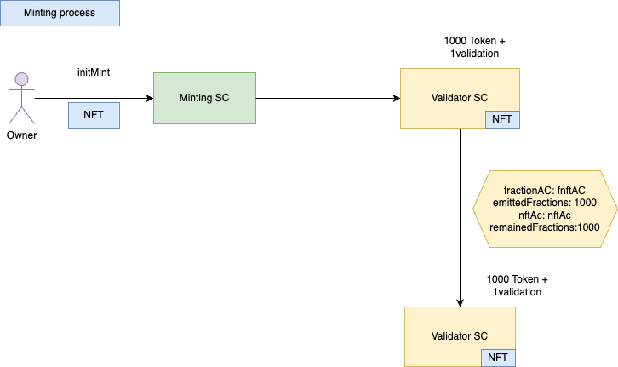
4. Flow diagram

Slide 6
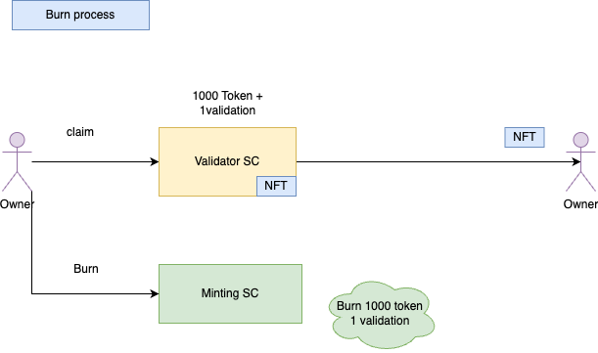
4. Flow diagram

Slide 7
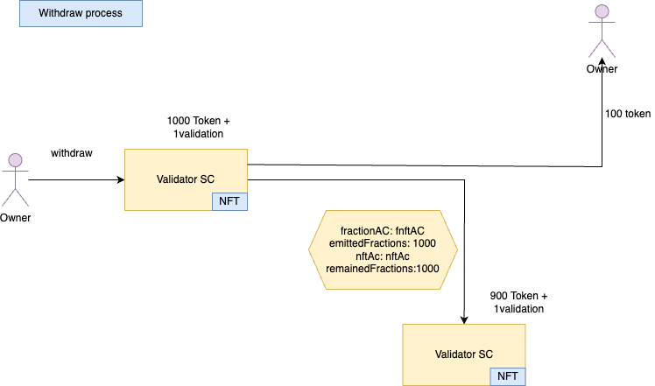
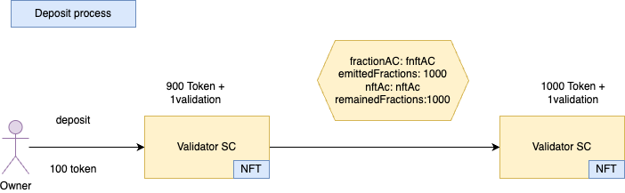
4. Flow diagram

Slide 8
4. Flow diagram

